Slide 1

Data 602: Introduction to Data Analysis and Machine Learning
DIGIT CLASSIFICATION
Presented by:
Gowtham Karaka(YM74533)
Venkat Akhil Mothe(IP03539)

Slide 2
Introduction
Objective:
Develop a machine learning system to accurately classify digits (0-9) based on 298 features extracted from binary images.
The dataset comprises various attribute files, including Fourier coefficients capturing shape details (mfeat-fou), profile correlations (mfeat-fac), and morphological features (mfeat-mor).
Explore various classification algorithms, optimize hyperparameters using grid search, and assess model performance through cross-validation.
Emphasize best practices in data preprocessing, regularization, and model evaluation to achieve robust and accurate digit classification.

Slide 3
About Data
Repository:
https://github.com/cvrg-iyte/DATA602repo.git.
DATA LOADING
Loaded into Python environment by pandas Library
read_csv_fuction is employed to read each attribute file with the resulting data frames as data1, data2, data3.
COMBINING FEATURES
After Loading, the features are combined by merging the three data frames.
Merged dataset comprises of 298 features, and 2000 columns forming the basis for subsequent analysis and machine learning tasks.
DATA SOURCE

Slide 4
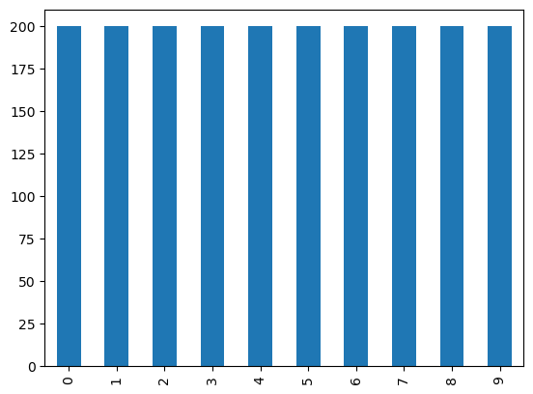
Exploratory Data Analysis
Class Balance Fosters Fair Learning:
The dataset exhibits a balanced distribution of samples across all classes, with precisely 200 instances for each digit (0-9) in the dataset of 2000 samples. This balance ensures that the machine learning model is exposed equally to the characteristics of each digit during the training phase.

Slide 5
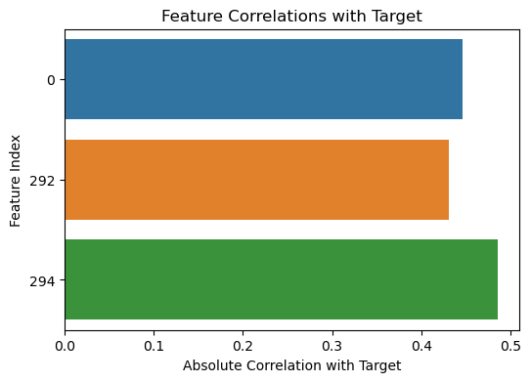
Correlation analysis
Conducting correlation analysis between each feature and the target variable (digit class) provides insights into the relevance of individual features in determining the digit identity. This analysis helps identify which attributes or characteristics contribute the most to distinguishing between different digits.
A high positive correlation between a feature and the target variable indicates that an increase in the feature value is associated with a higher likelihood of belonging to a specific digit class.
Features with low correlation may have limited impact on digit classification

Slide 6
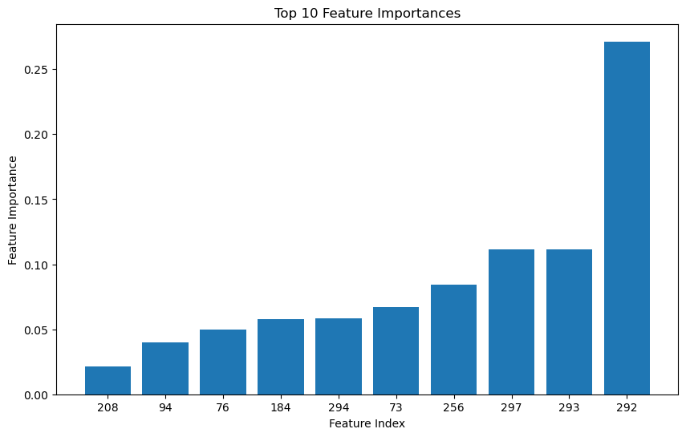
Feature Importance
We have Used Decision Tree Classifier to extract and identify top-10 Features.

Slide 7
Models Used
Logistic Regression
LR
Accuracy: 0.95
Decision Tree
DT
Accuracy: 0.94
Random Forest
RF
Accuracy: 0.98
SVM
SVM
Accuracy: 0.96

Slide 8
THANK YOU

